Slide 1

GEOG 4/590: Geospatial Data Science
Lecture 7: Data access
Email: jryan4@uoregon.edu
Office: 163A Condon Hall
Office hours: Mondays 14:00-16:00

Slide 2
GEOG 4/590: Geospatial Data Science
Lecture 7: Data access
Code review – Assignment 5 (machine learning house prices)
Data access: APIs
Data access: Web scraping
Web scraping in my own research
Email: jryan4@uoregon.edu
Office: 163A Condon Hall
Office hours: Mondays 14:00-16:00

Slide 3
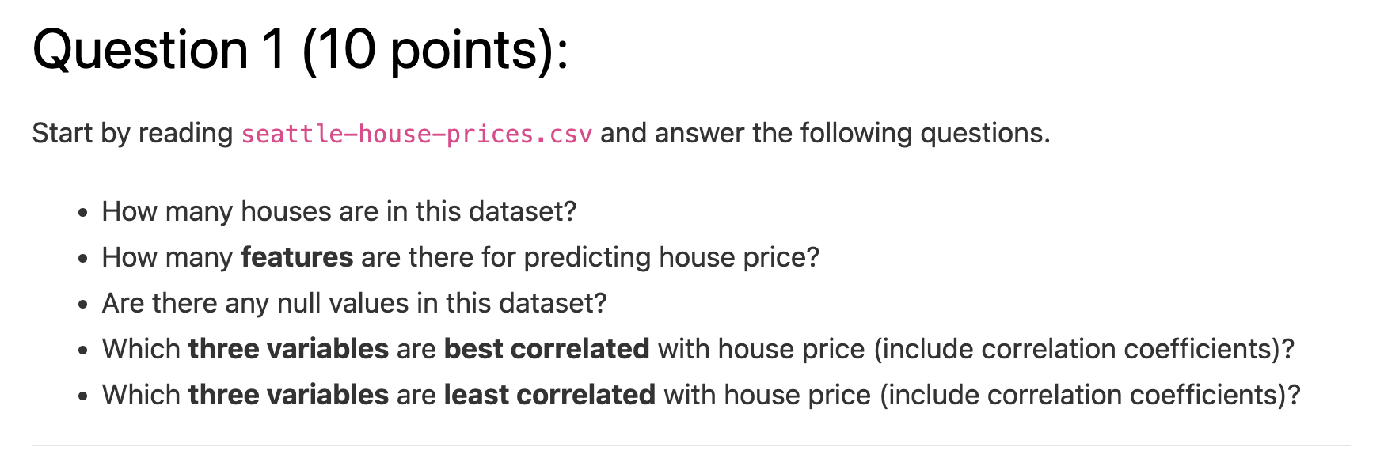
Code review: Assignment 5

Slide 4
Code review: Assignment 5

Slide 5
Code review: Assignment 5

Slide 6
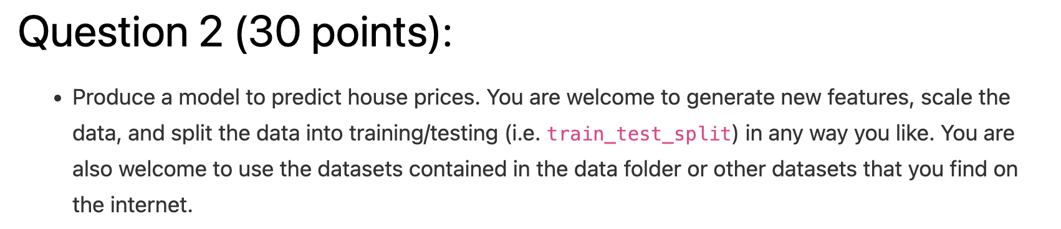
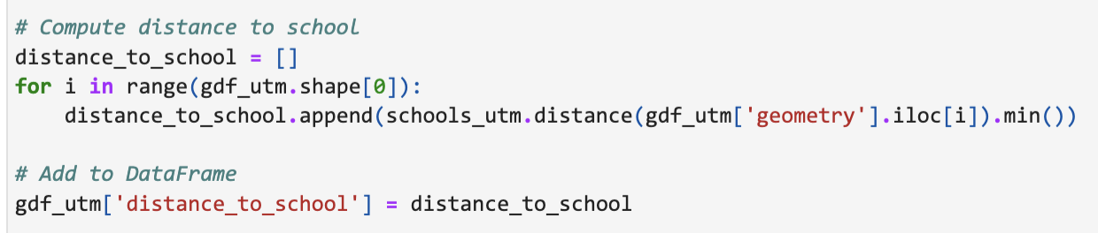
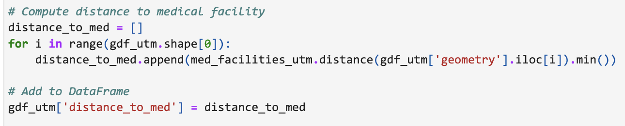

Slide 8
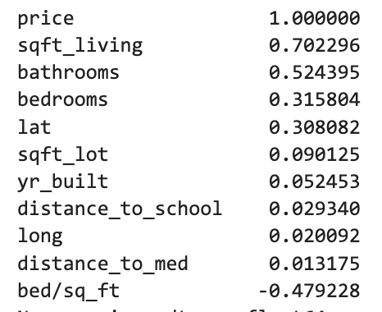

Slide 9
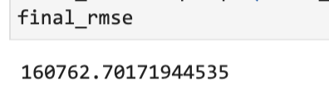

Slide 10
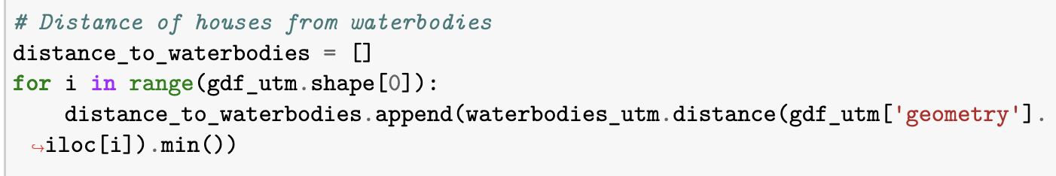
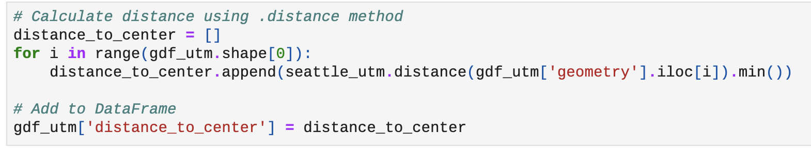
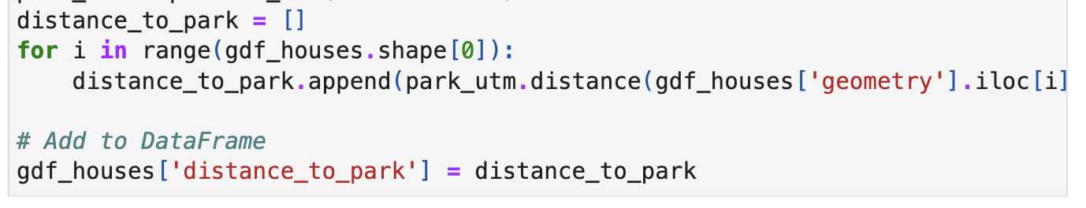
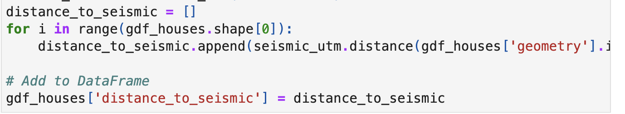
Notes:
Flood zones, highways, trails, railroads, and even landslides

Slide 11
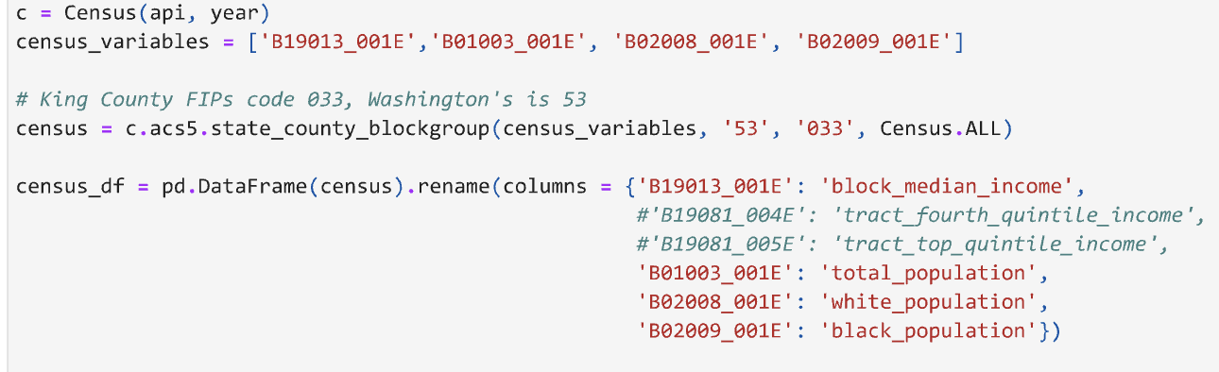

Slide 12
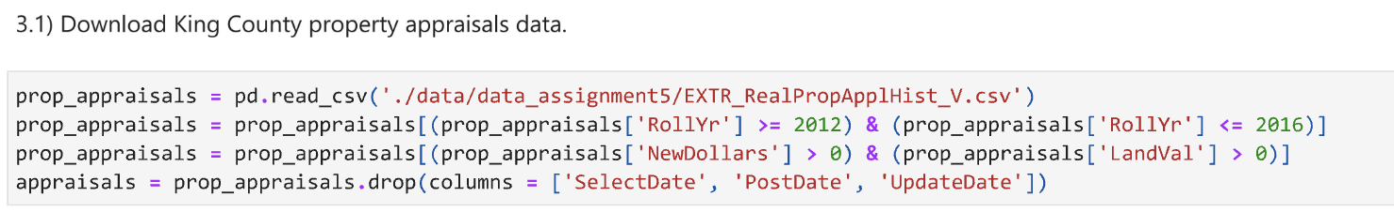

Slide 13
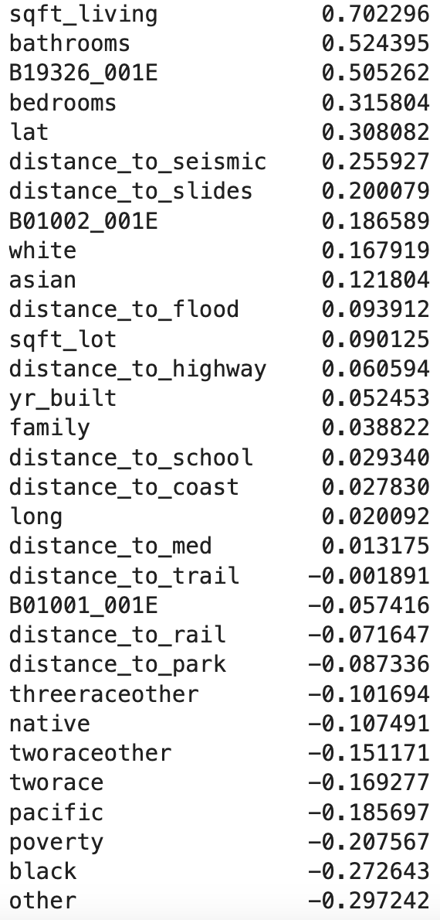
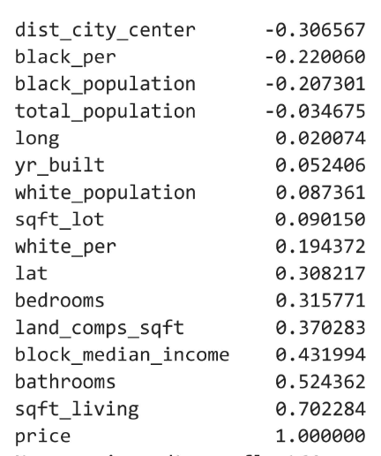
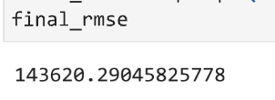
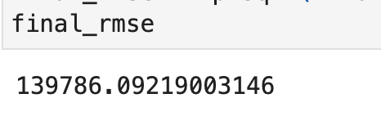
Notes:
B19326_001E = Median income

Slide 14
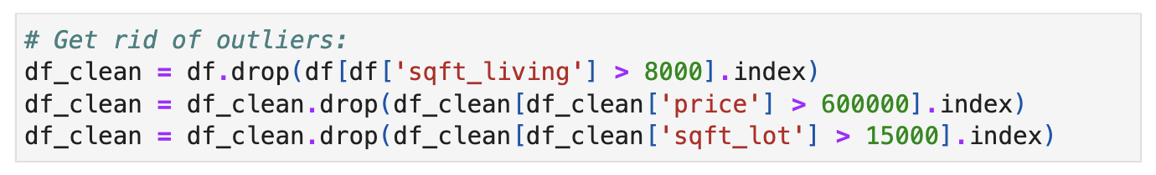

Slide 15
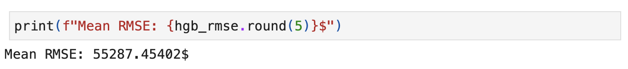

Slide 16
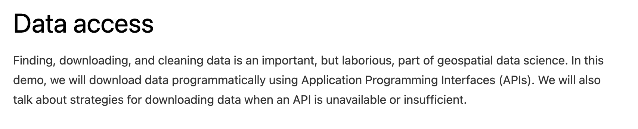

Slide 17
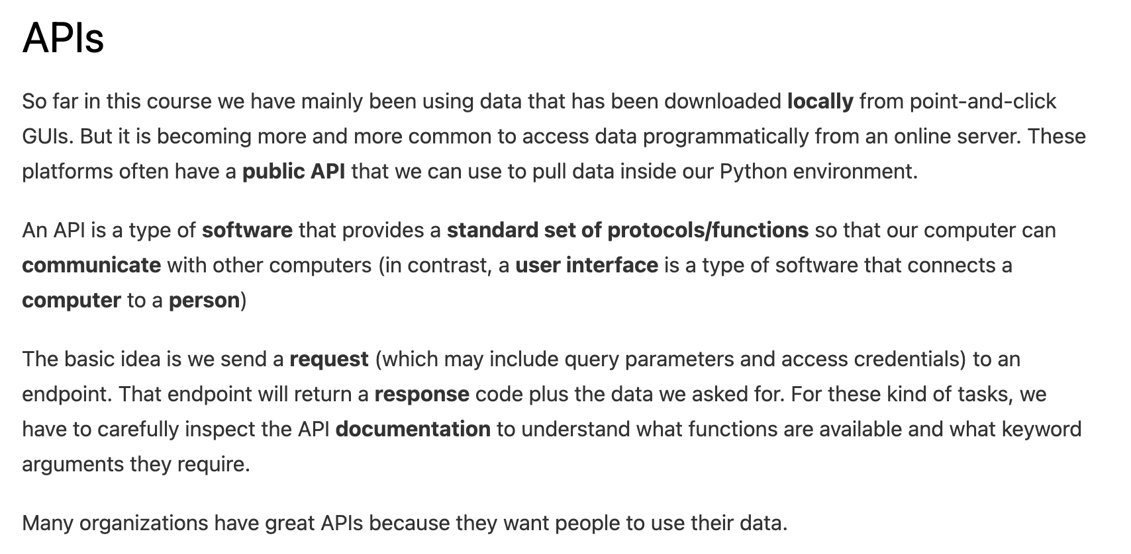

Slide 21
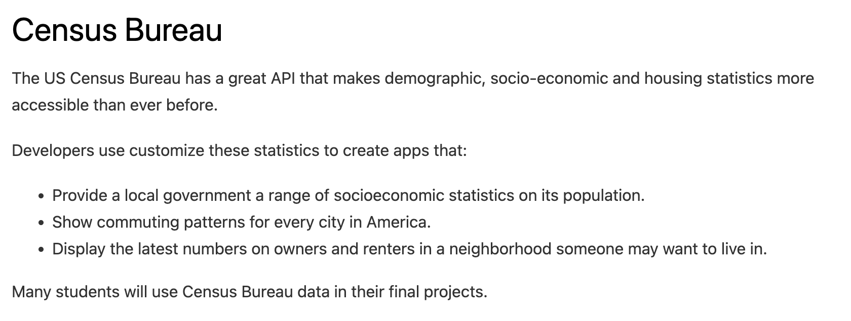

Slide 22
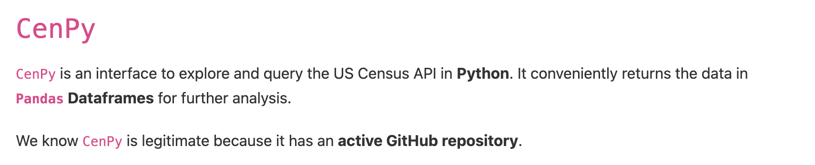

Slide 23
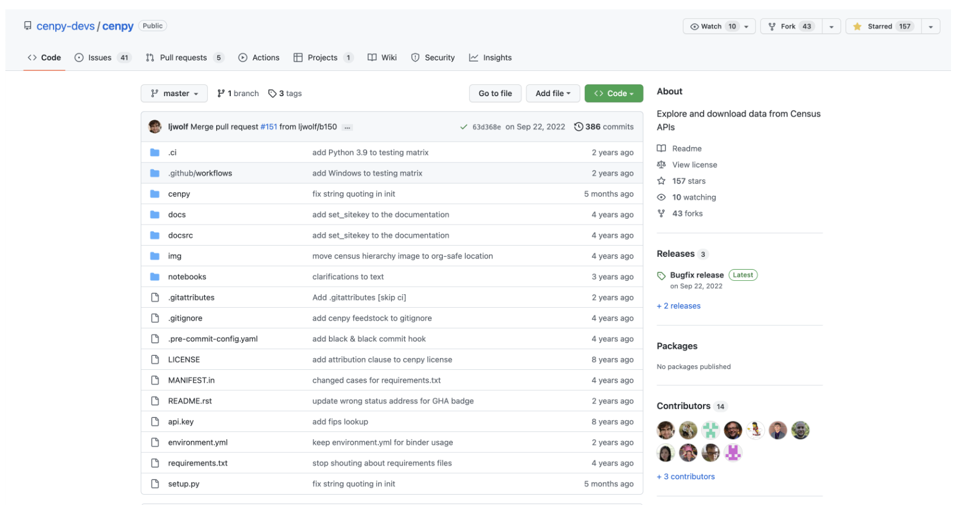

Slide 24
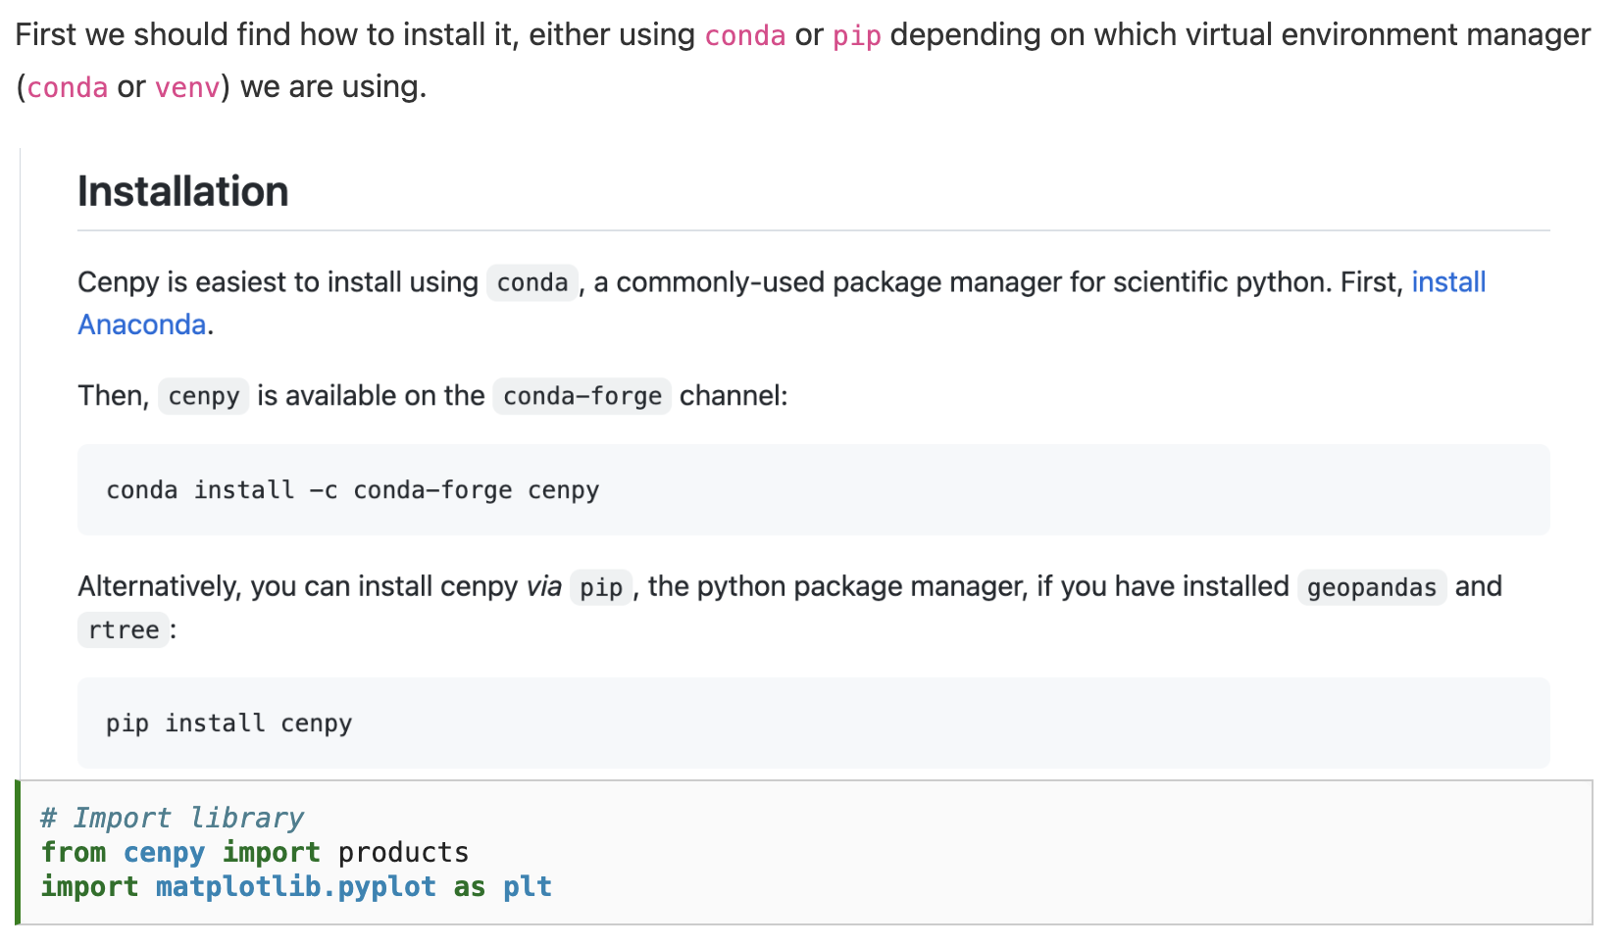

Slide 27
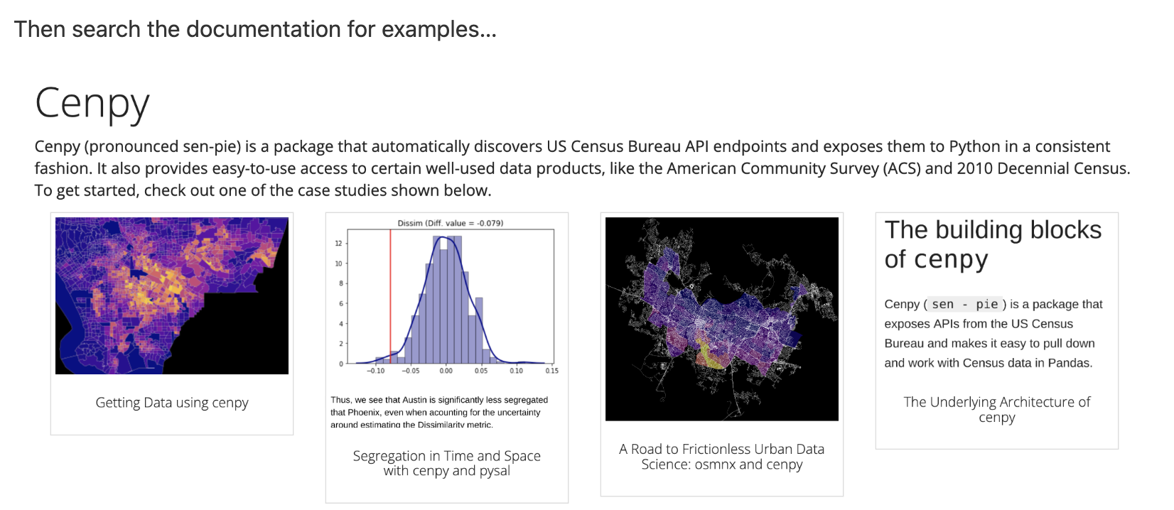

Slide 28
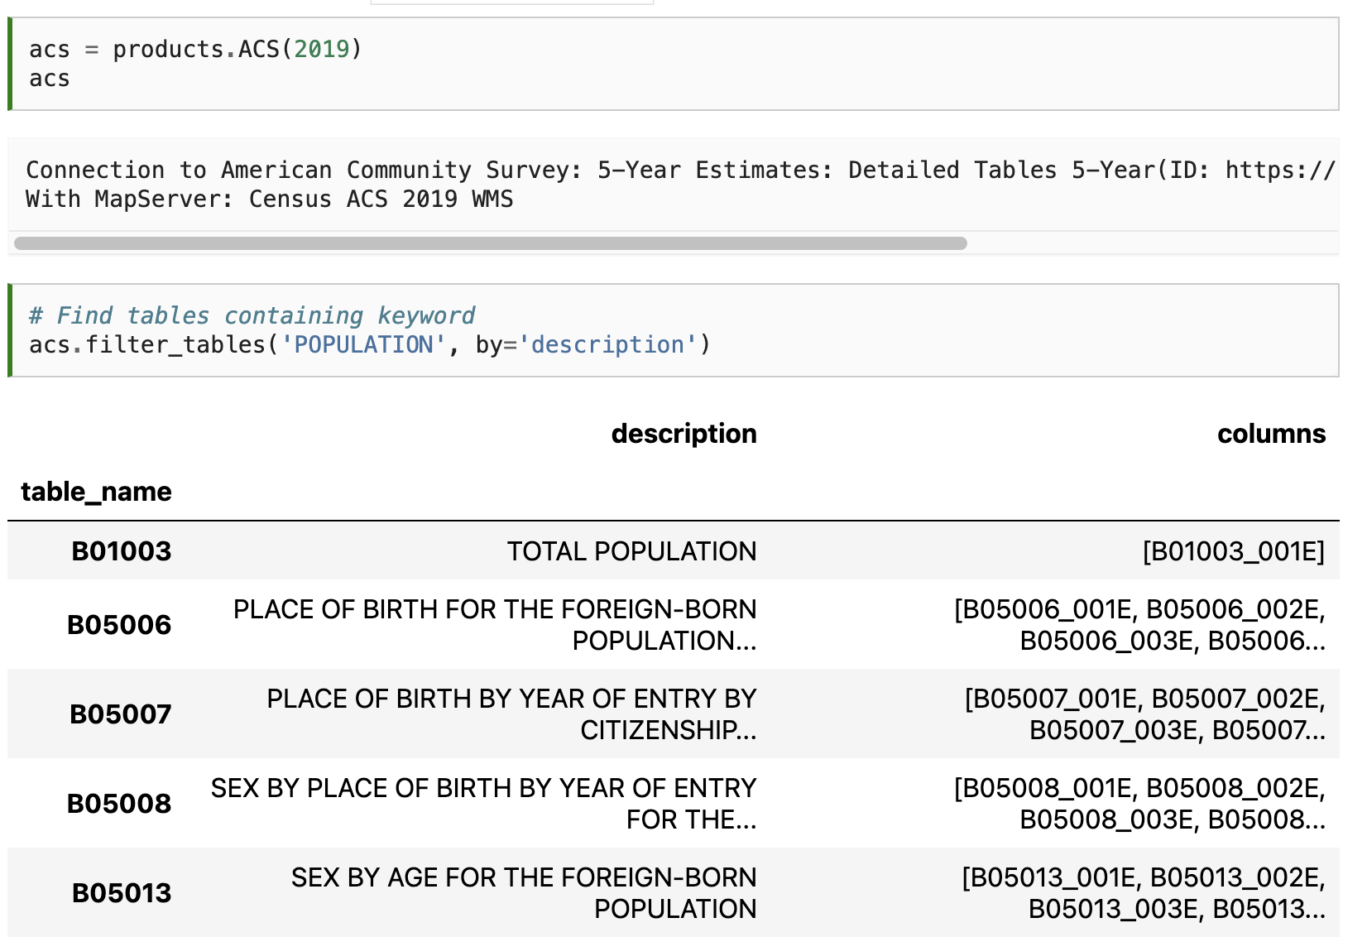

Slide 30
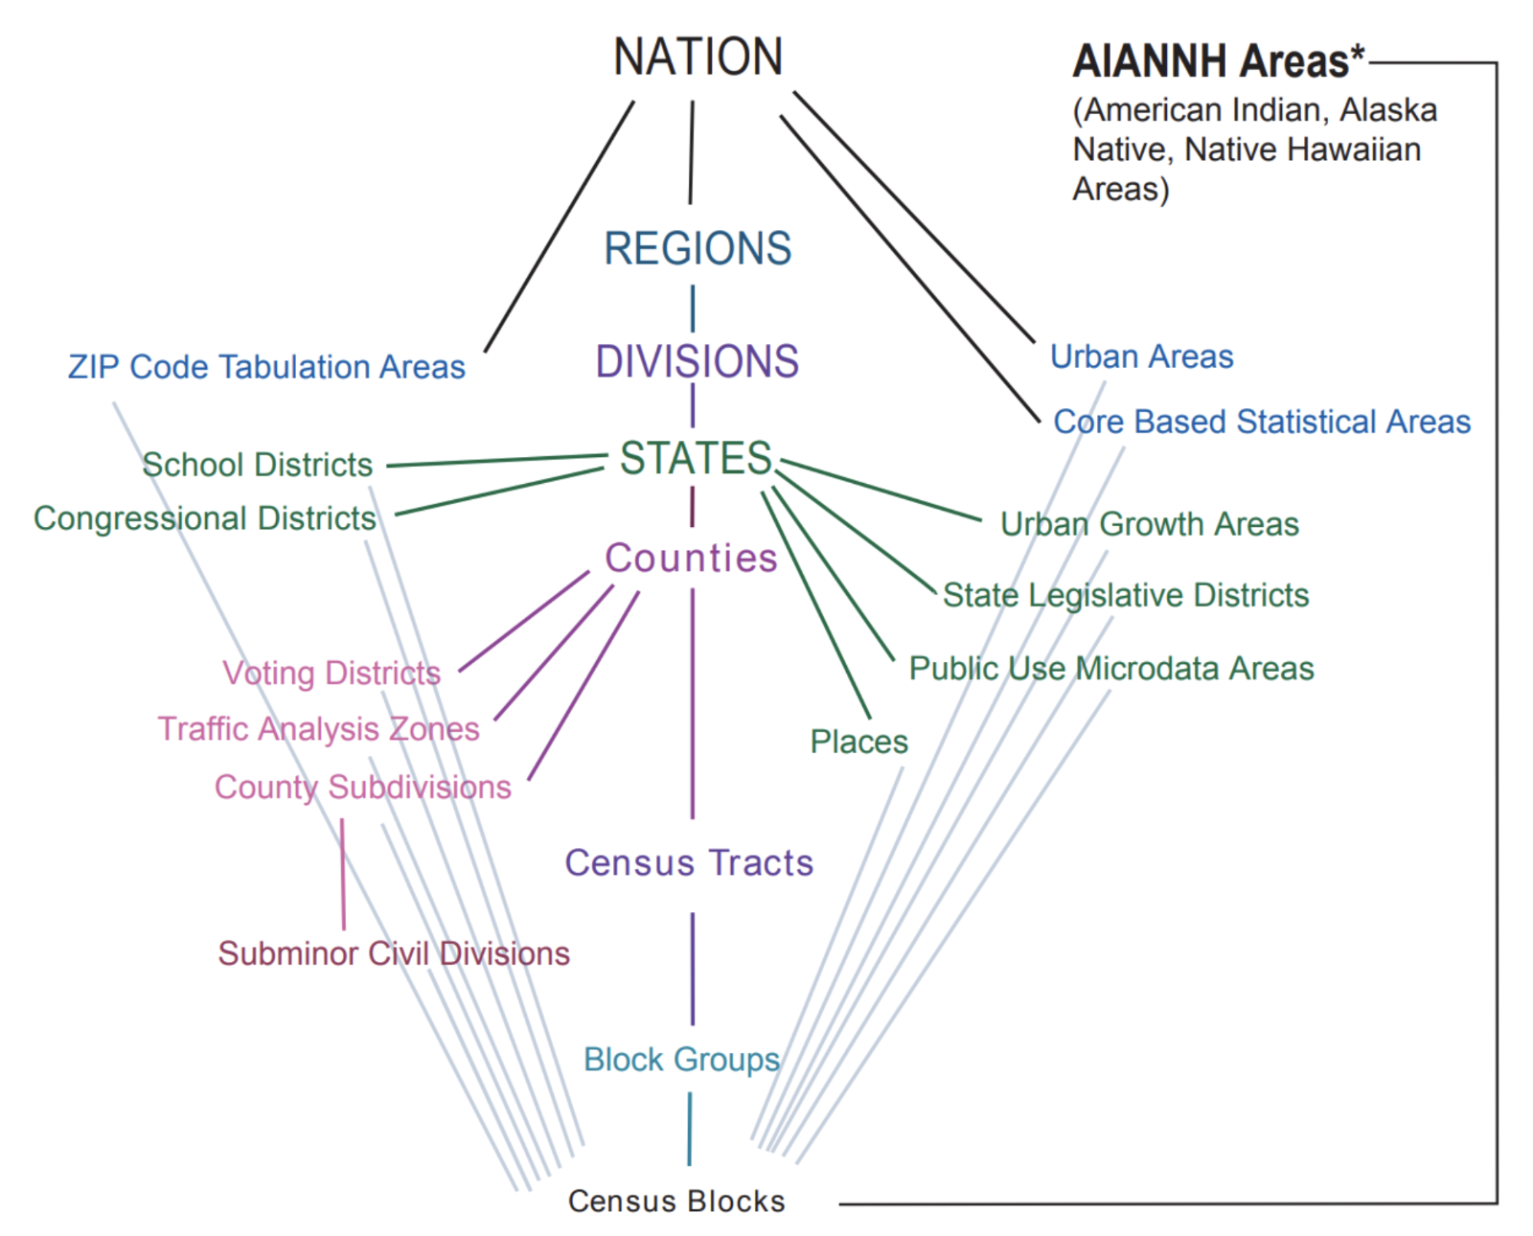

Slide 31
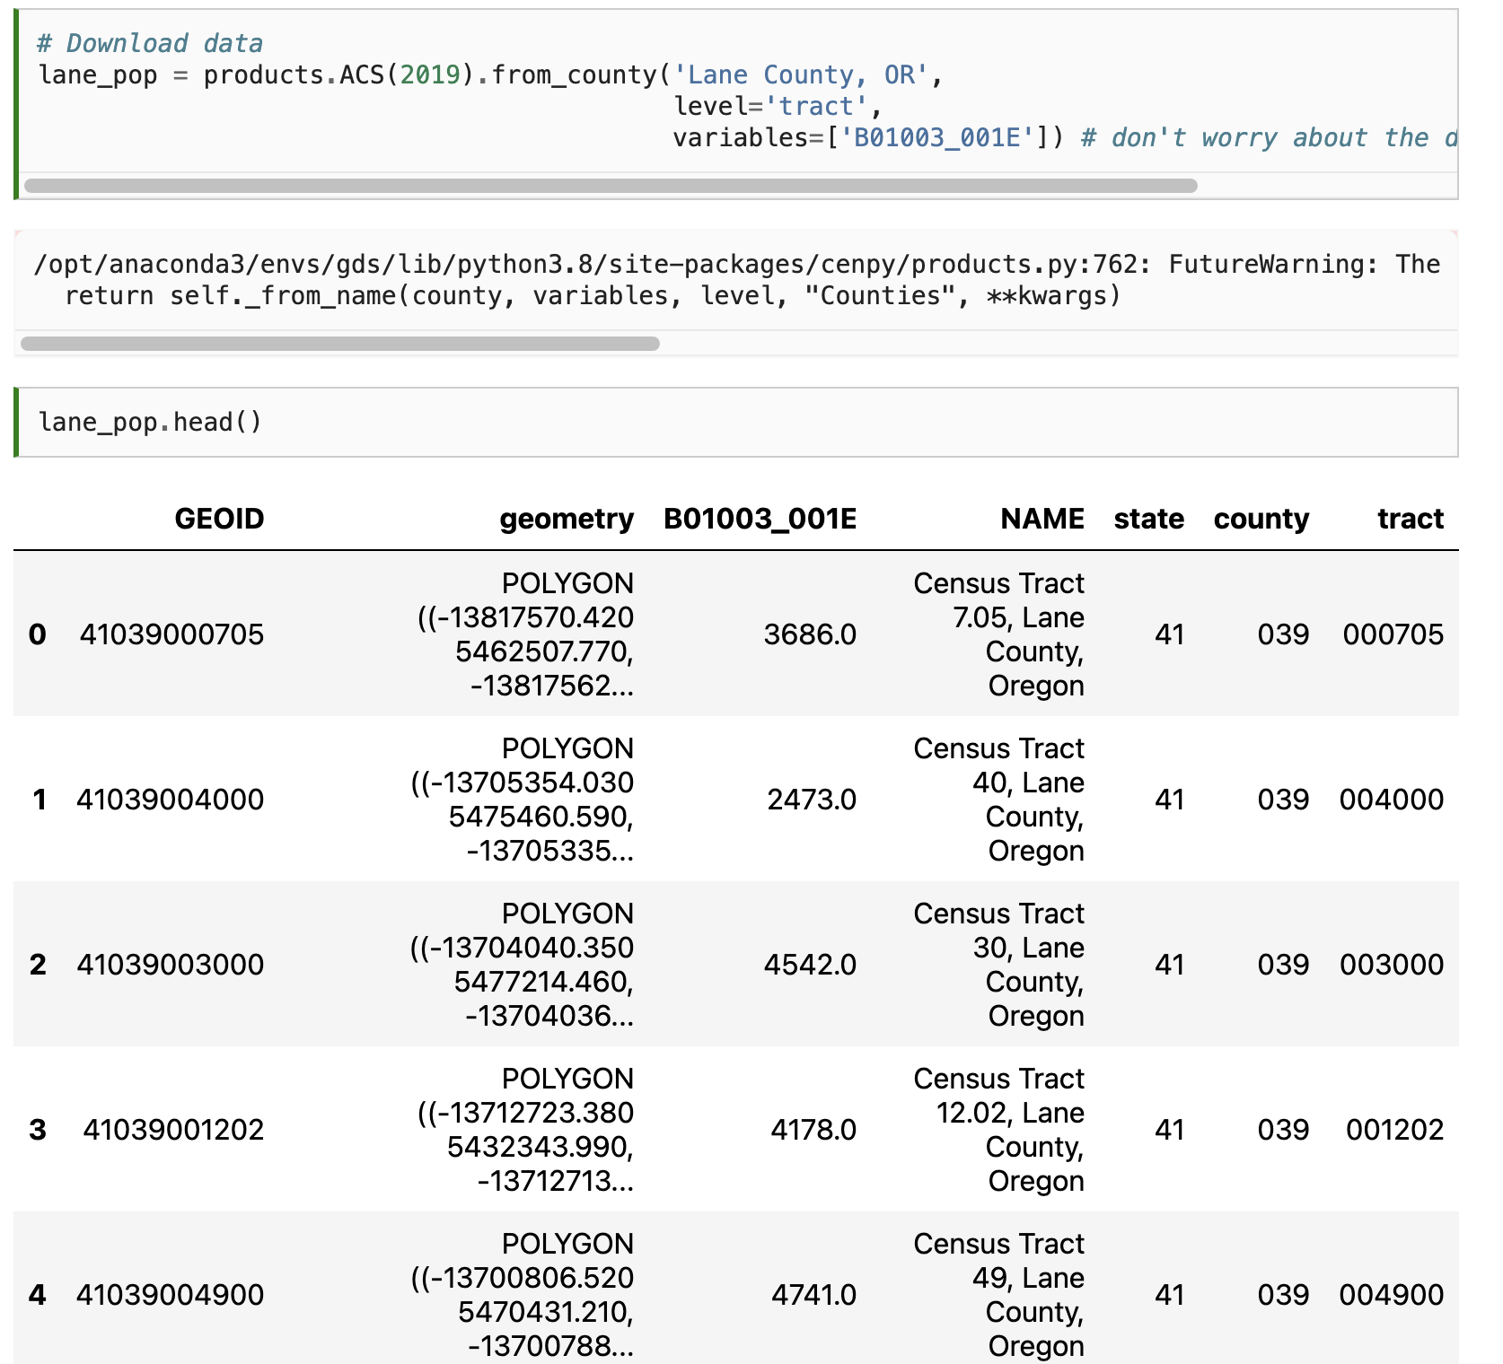

Slide 33
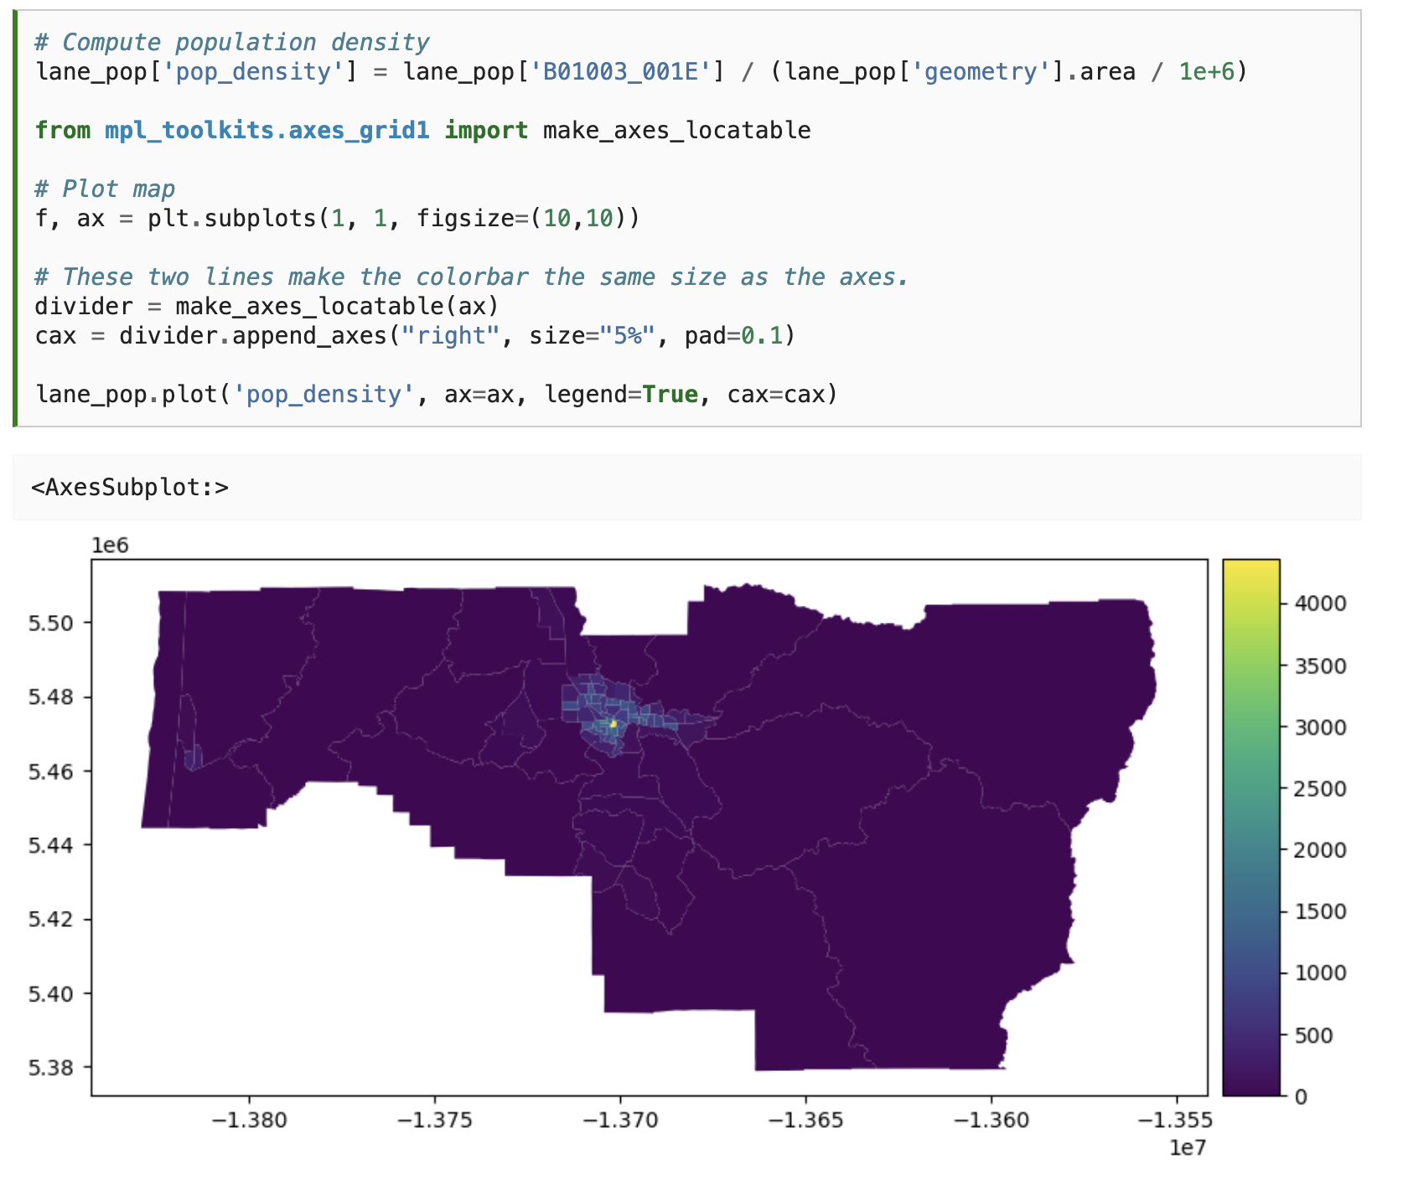

Slide 34


Slide 35
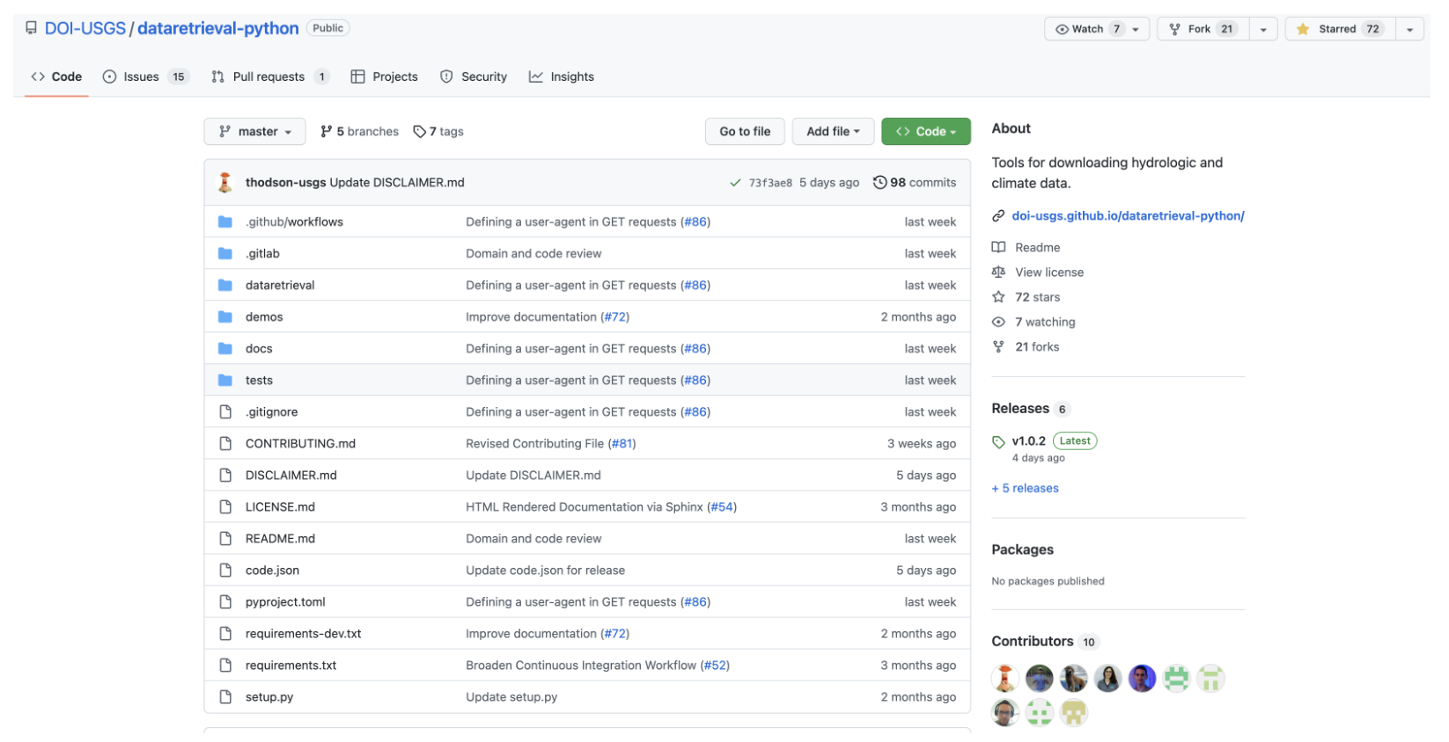

Slide 36
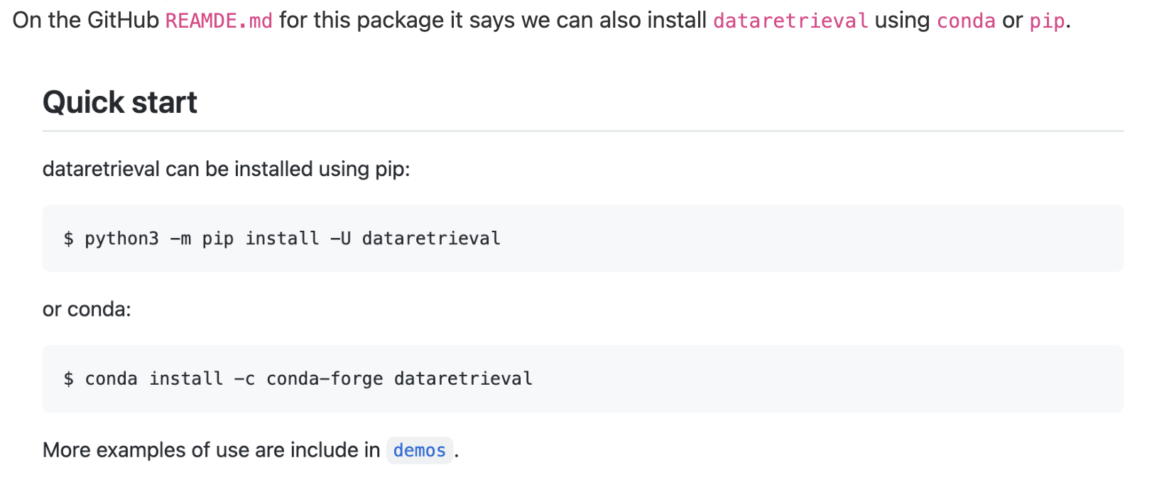

Slide 37
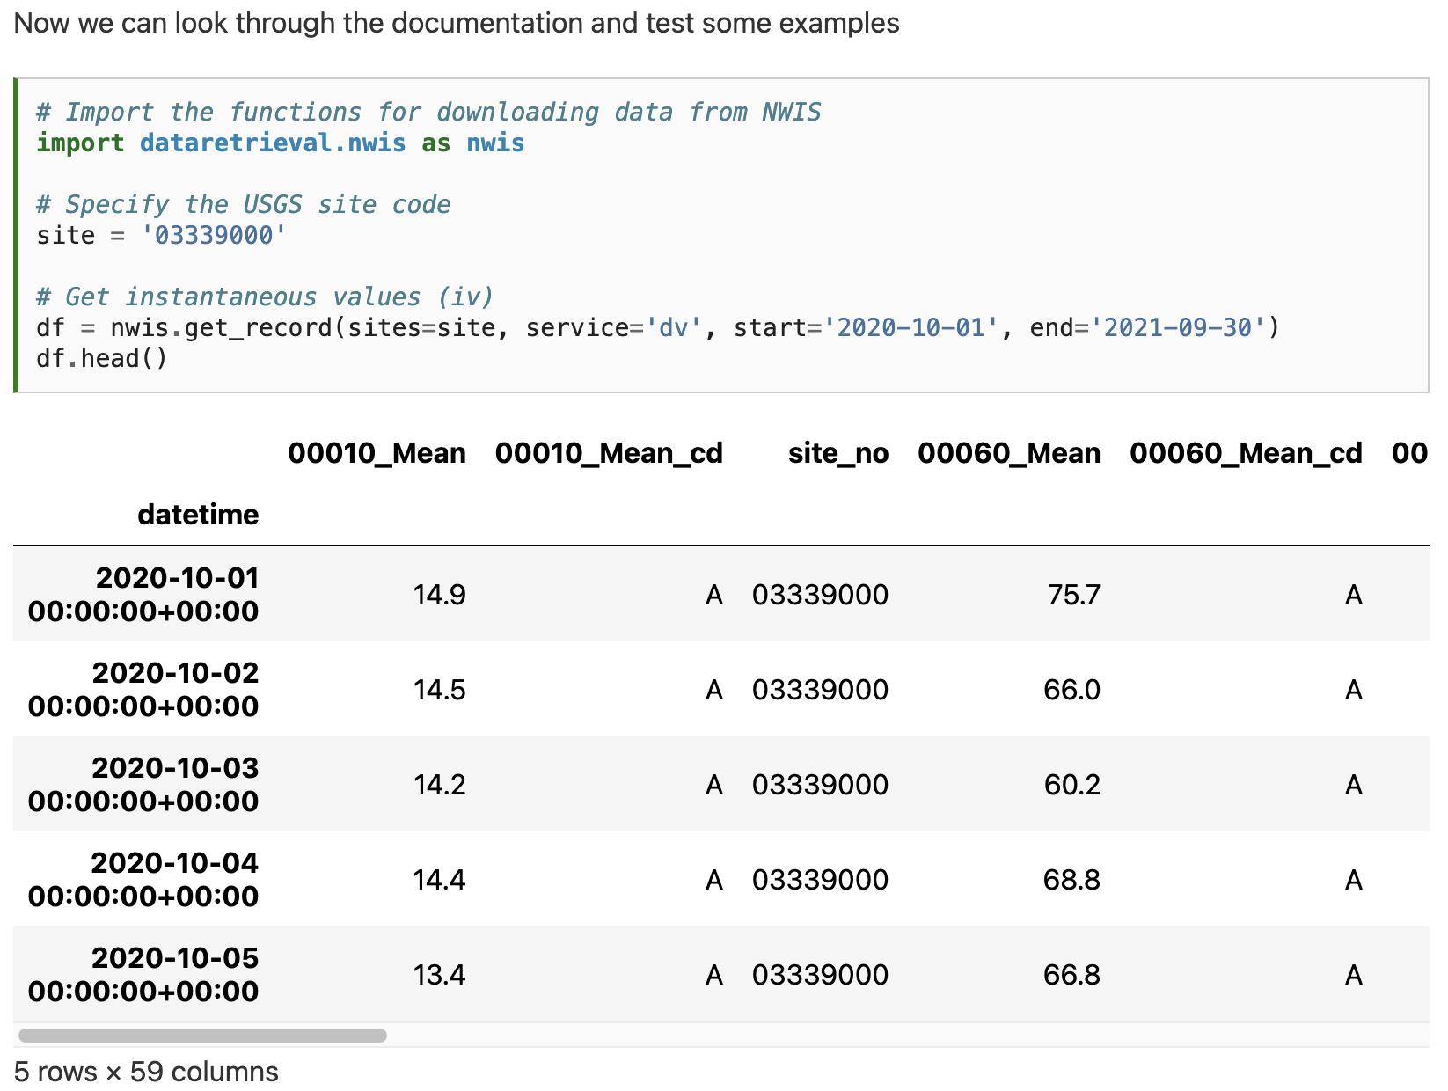

Slide 38
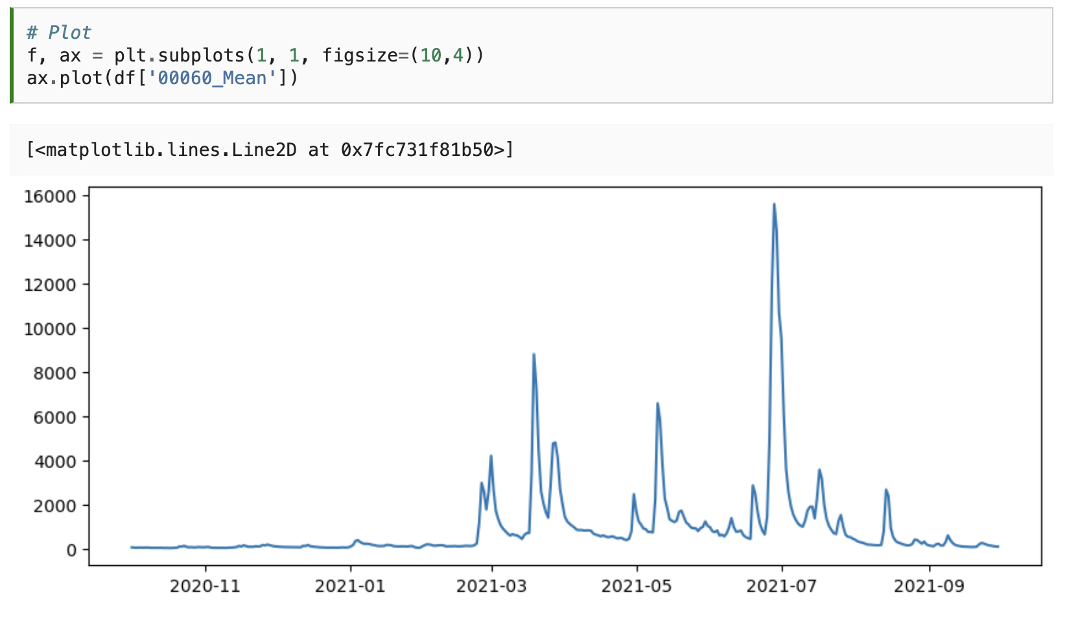

Slide 39
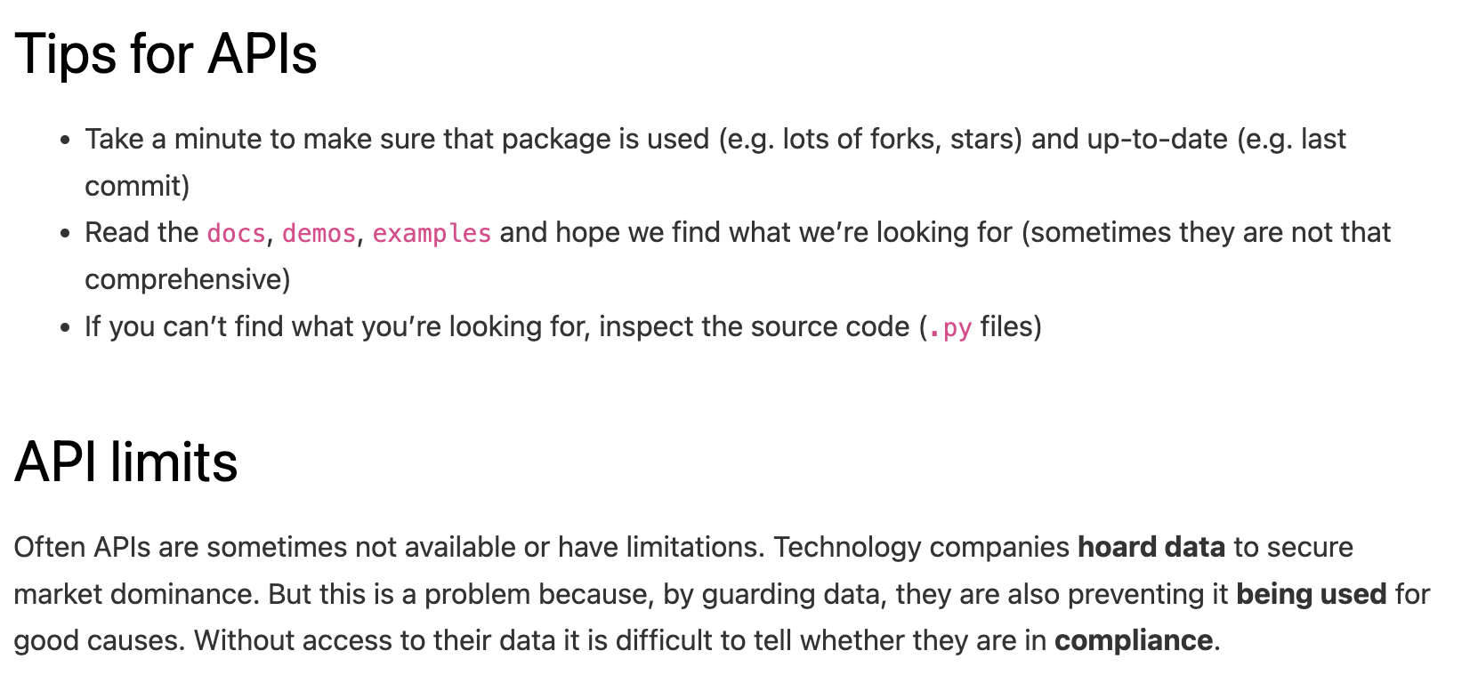

Slide 41
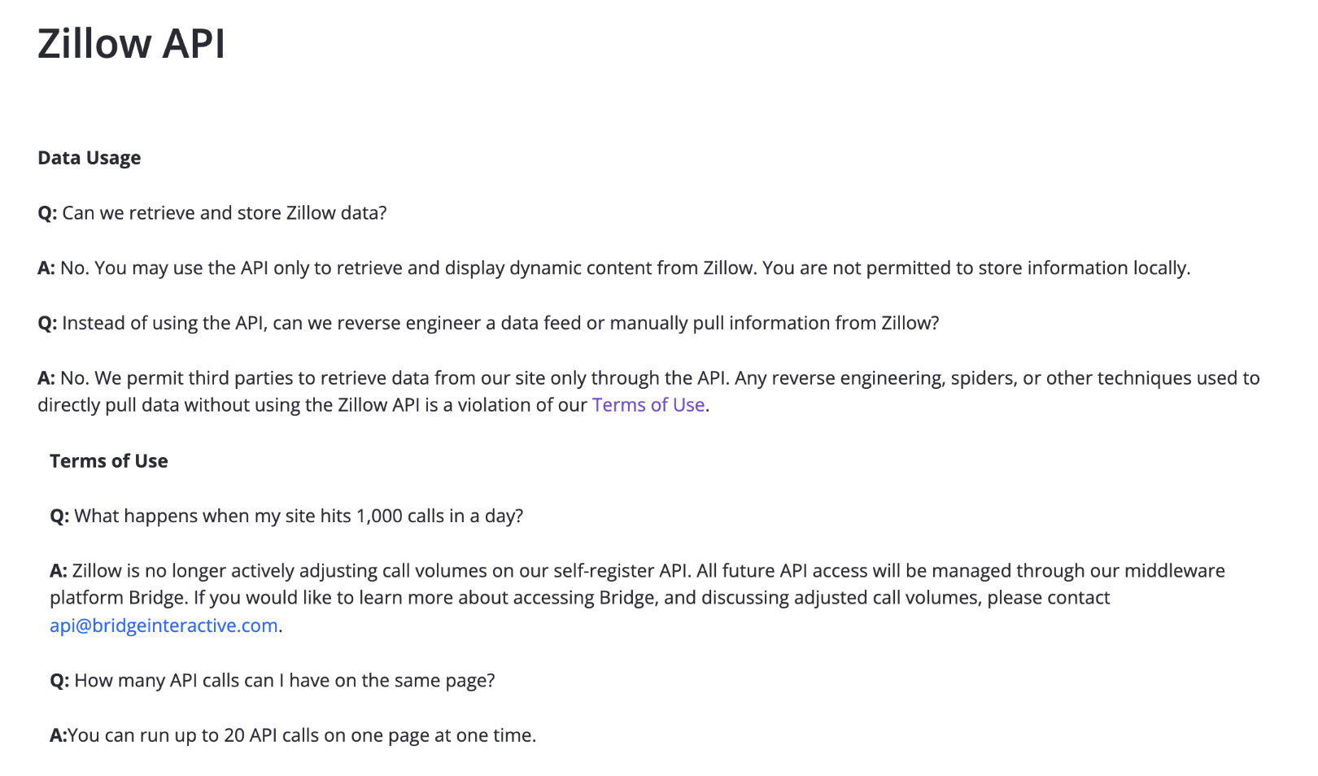

Slide 43
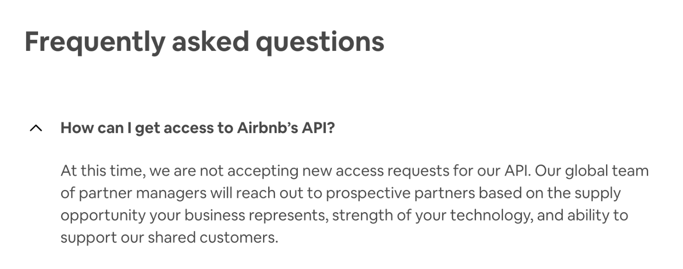

Slide 44
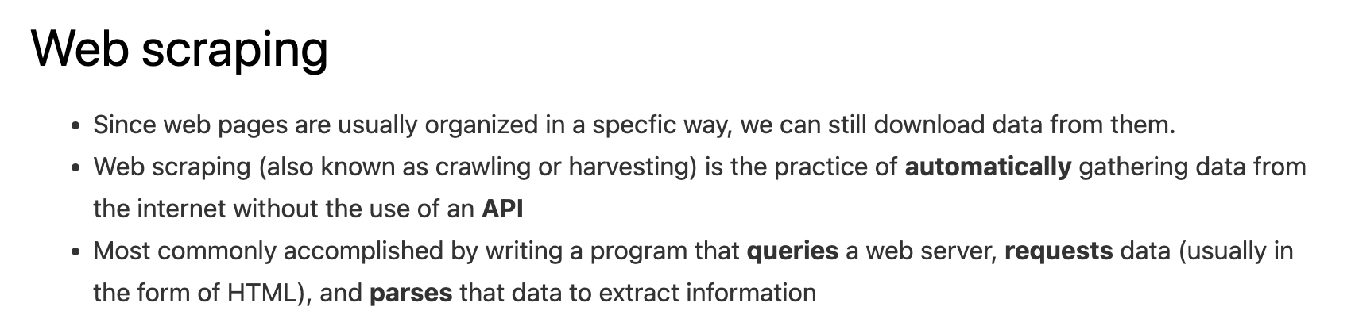

Slide 45
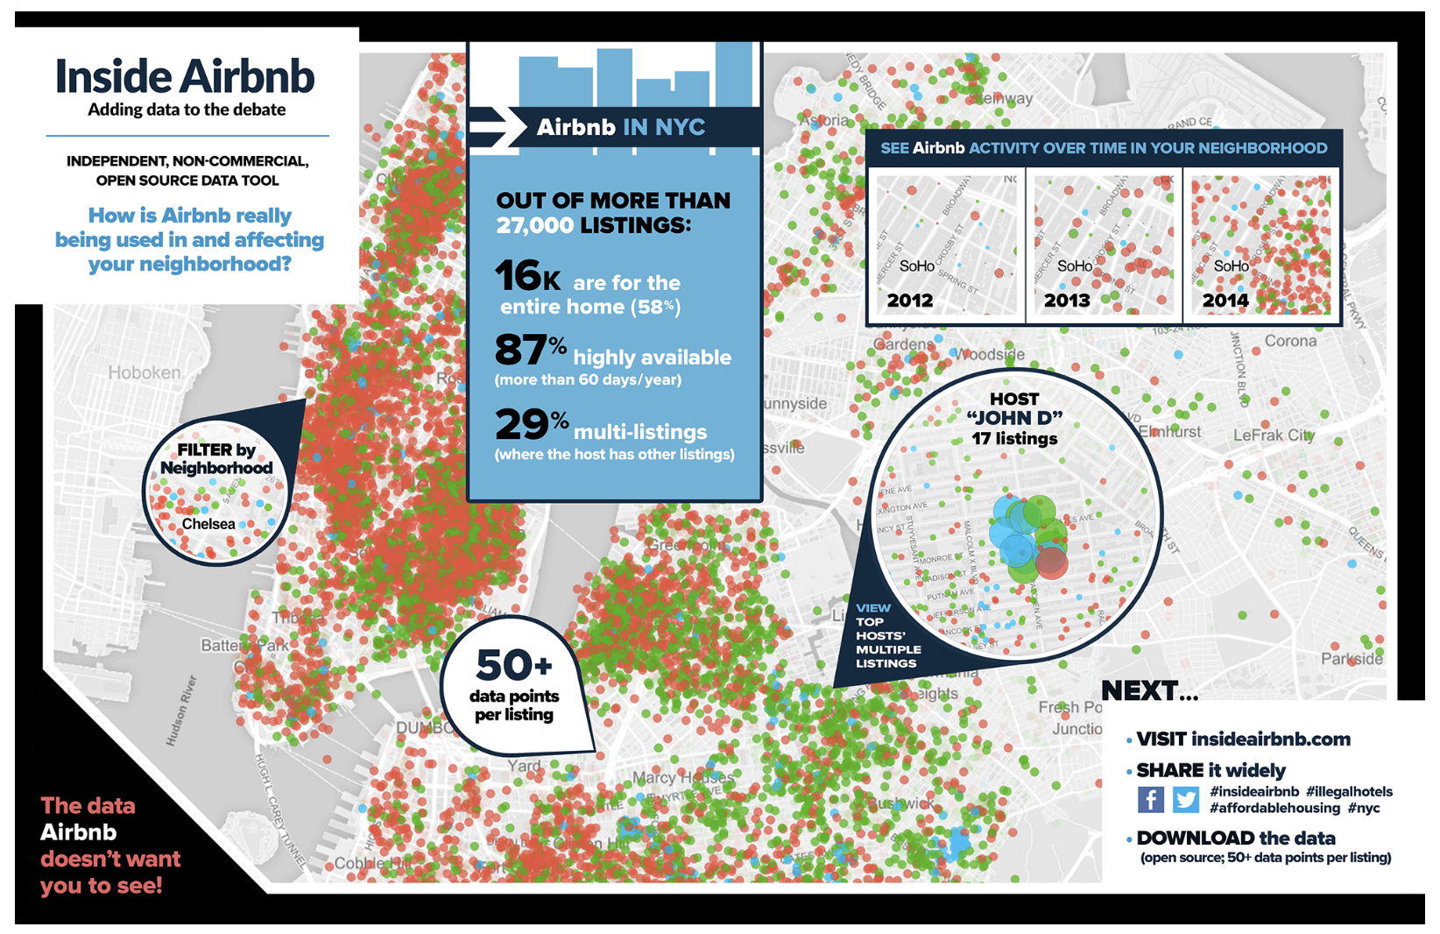
Notes:
Vigilantes showing that AirBnBs were not in compliance.

Slide 46
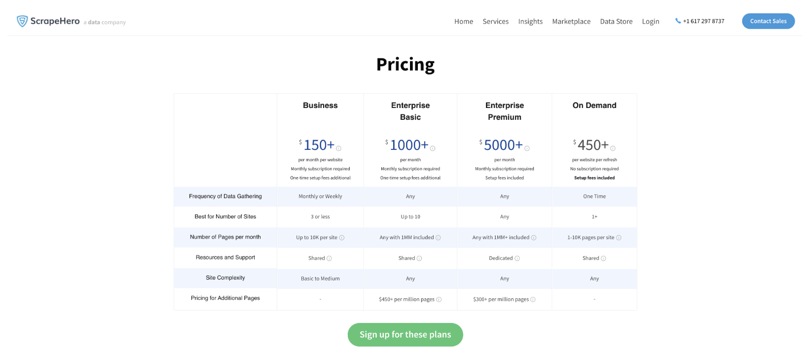

Slide 47
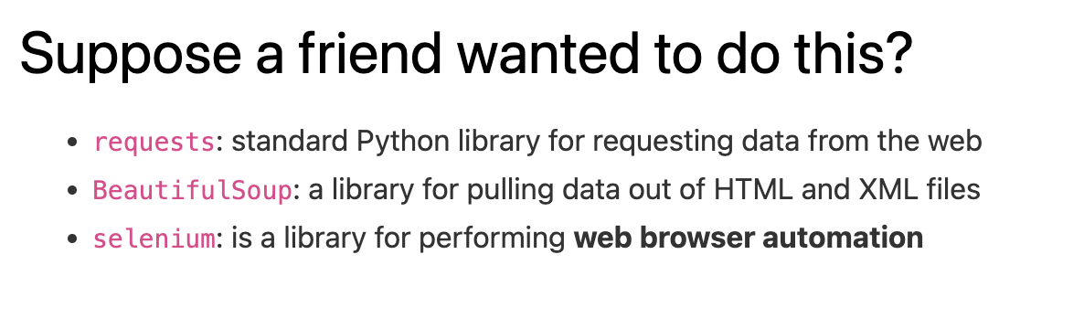

Slide 48
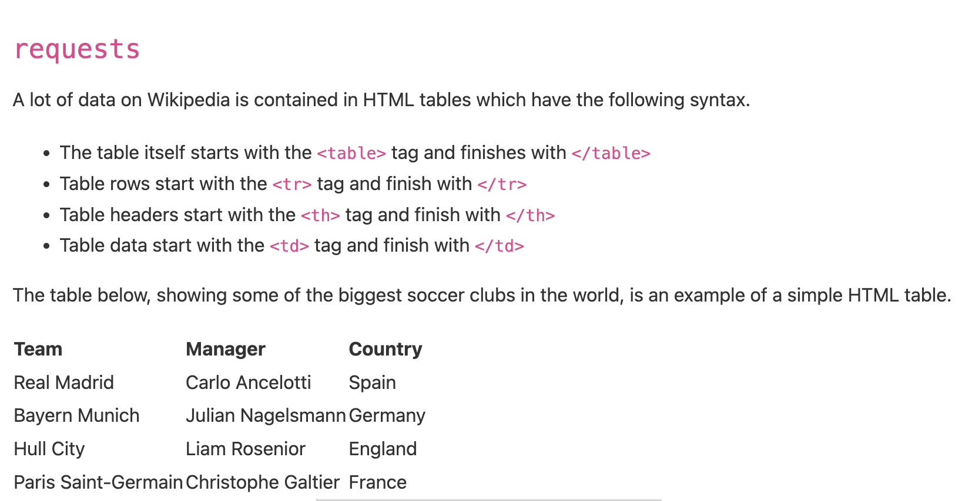

Slide 49
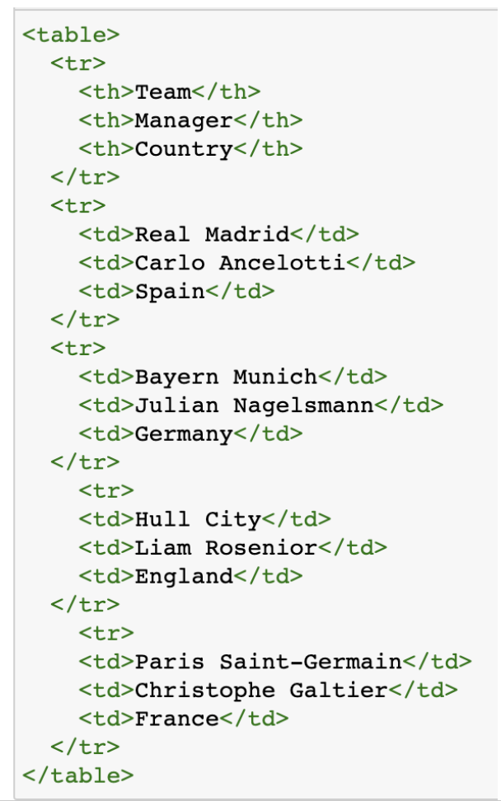

Slide 50
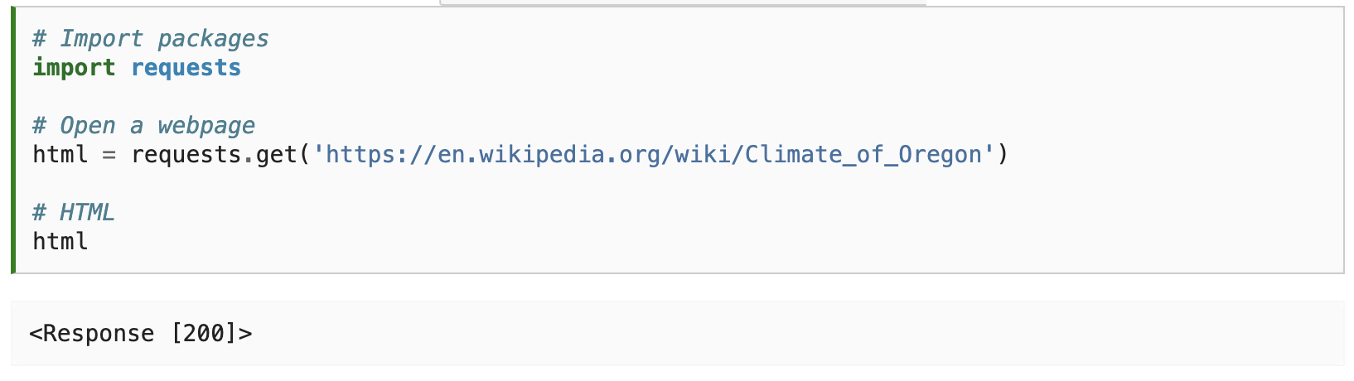

Slide 51
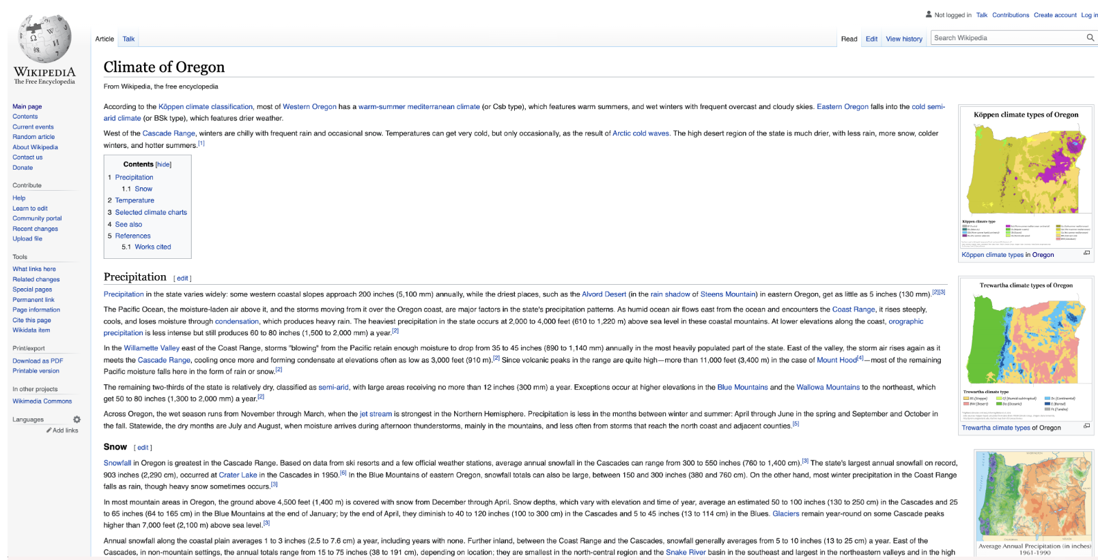

Slide 52
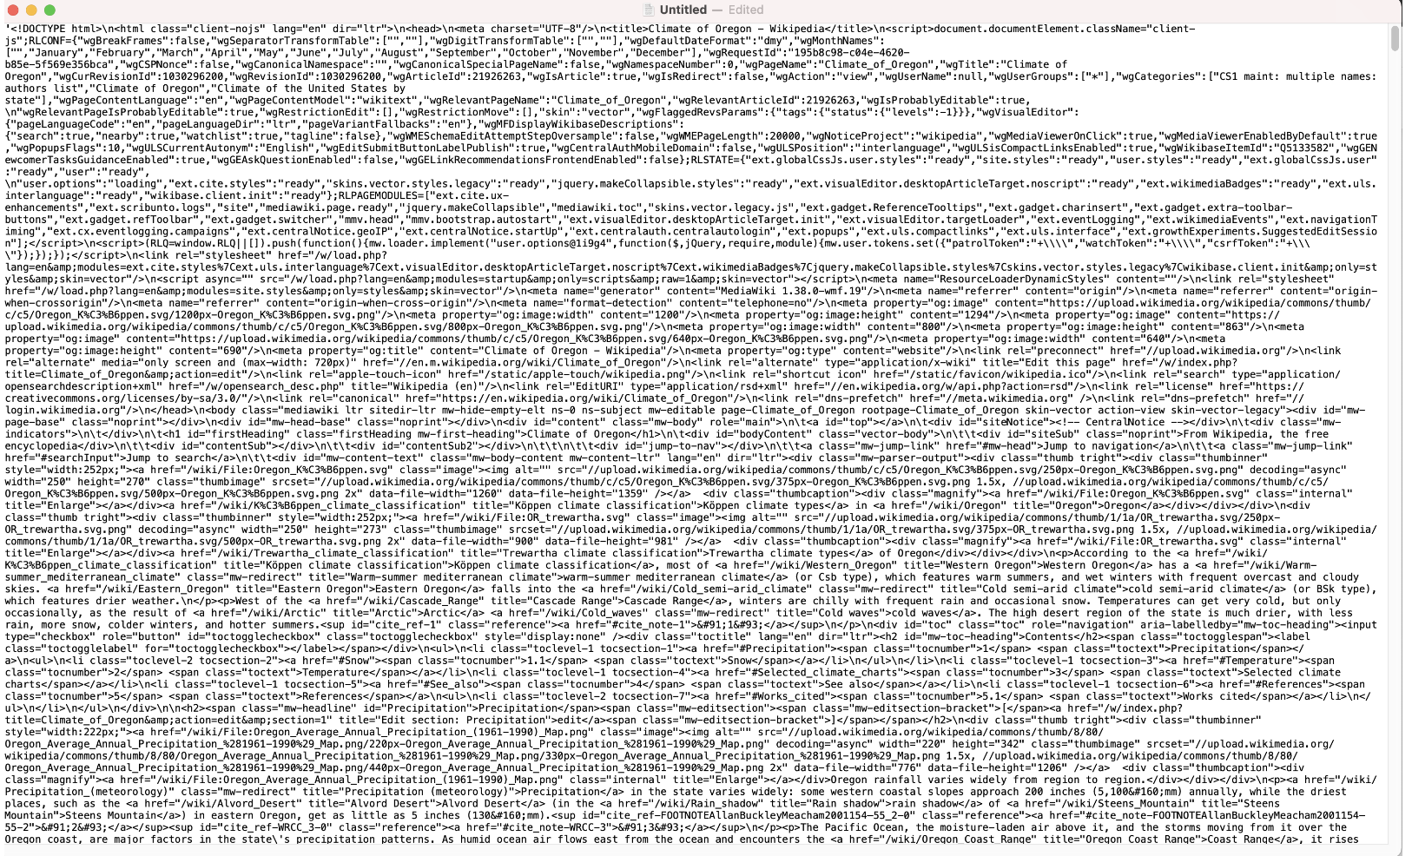

Slide 53
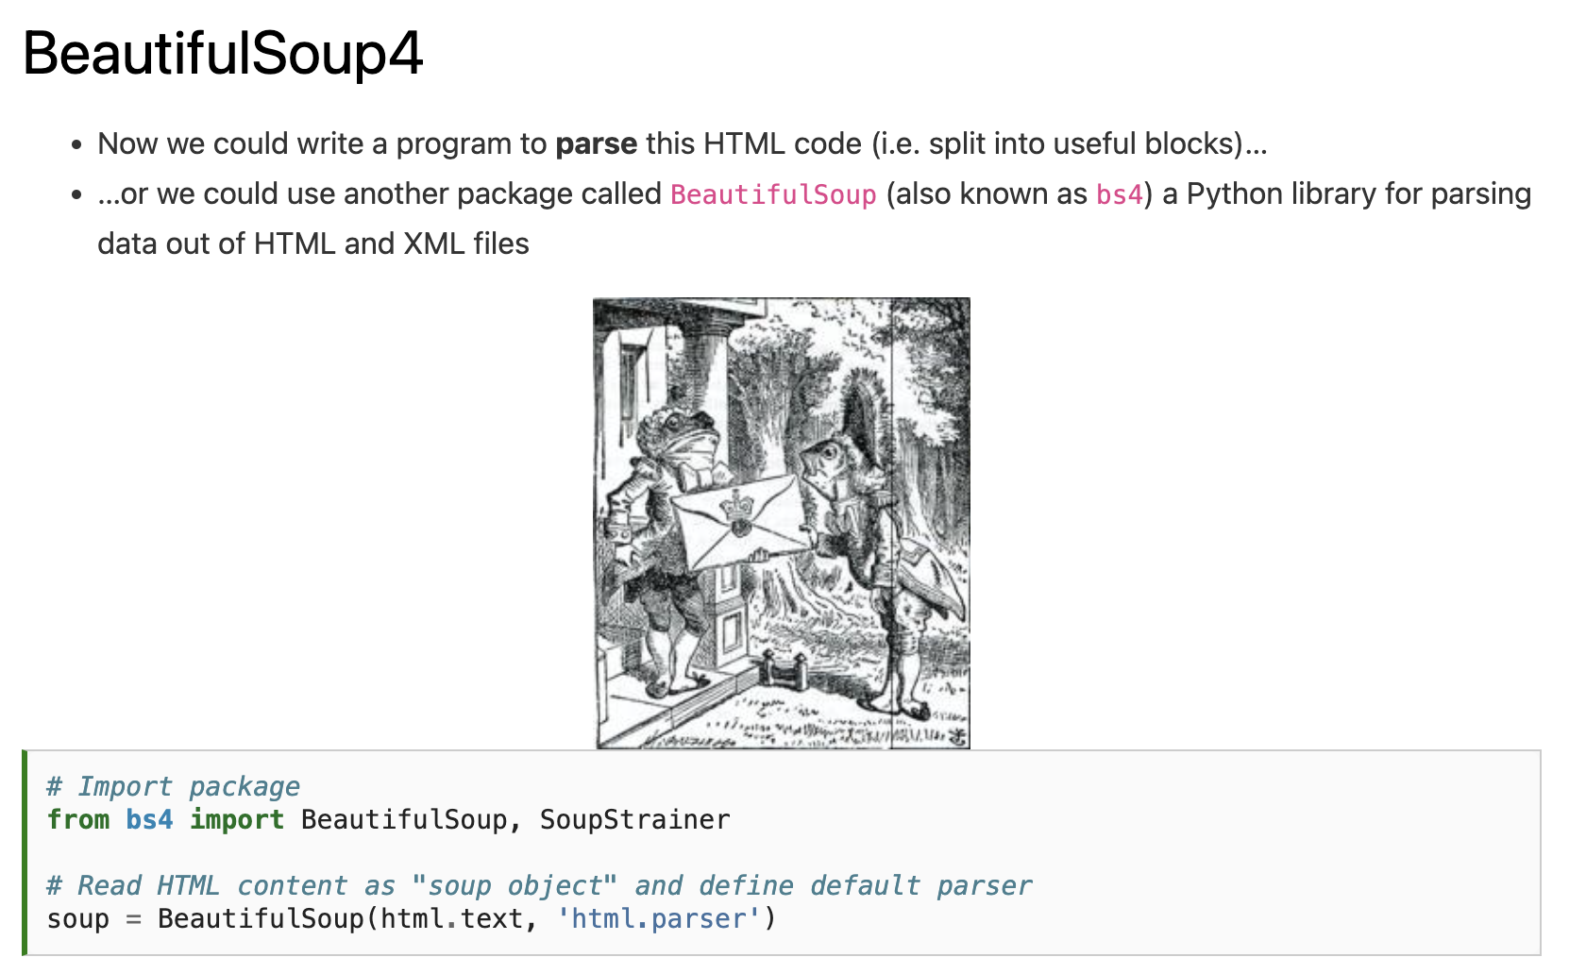

Slide 55
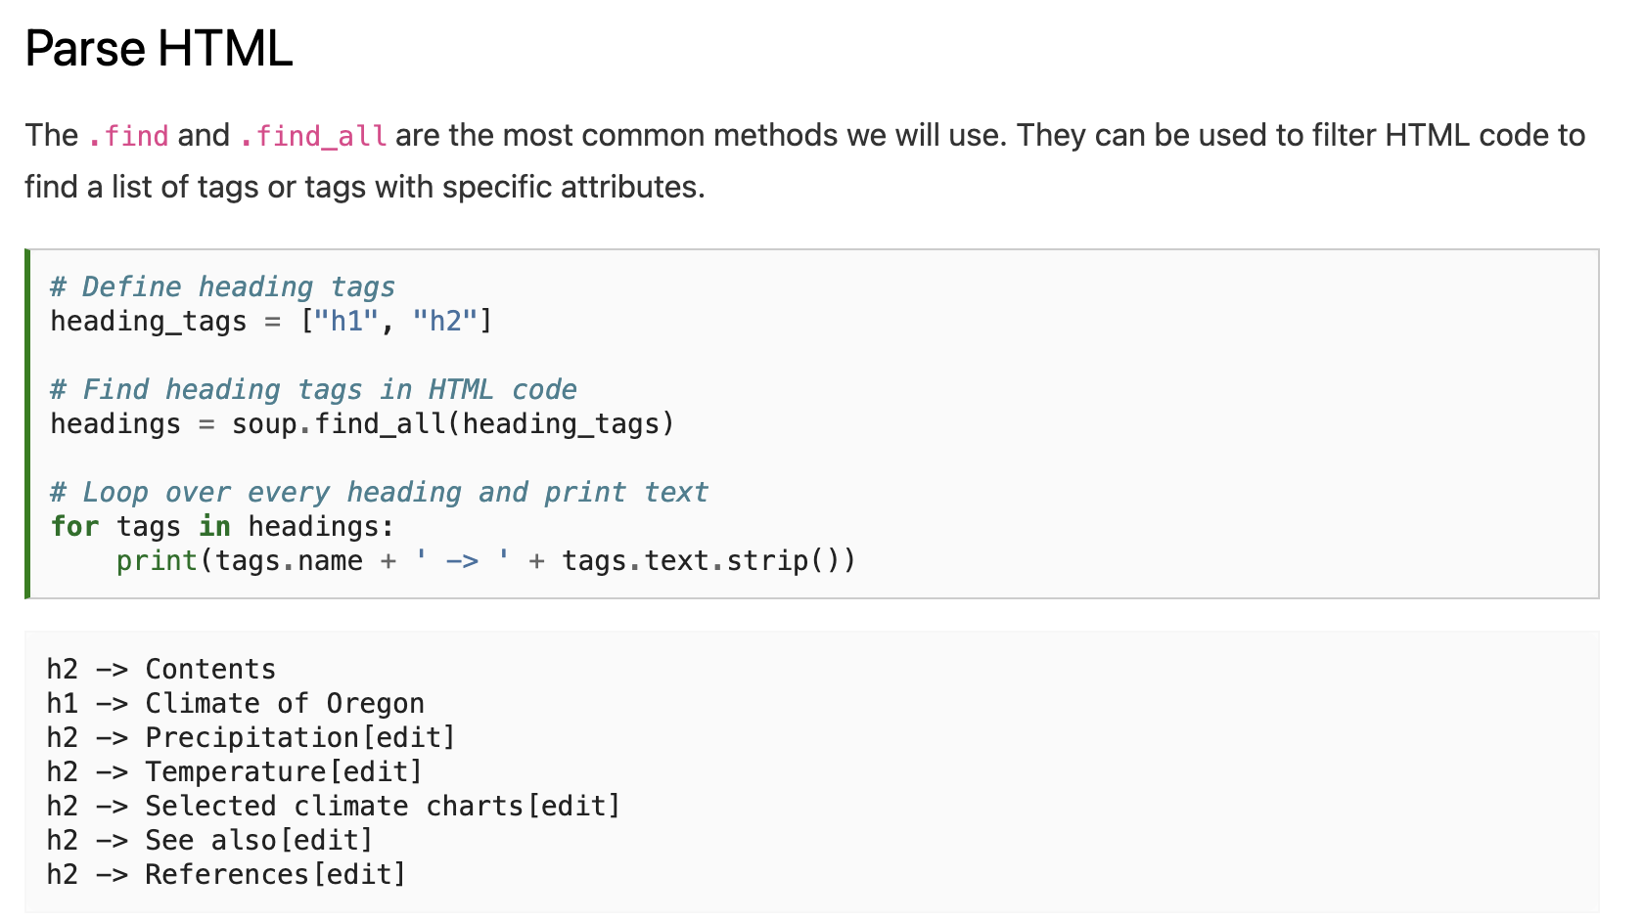

Slide 58
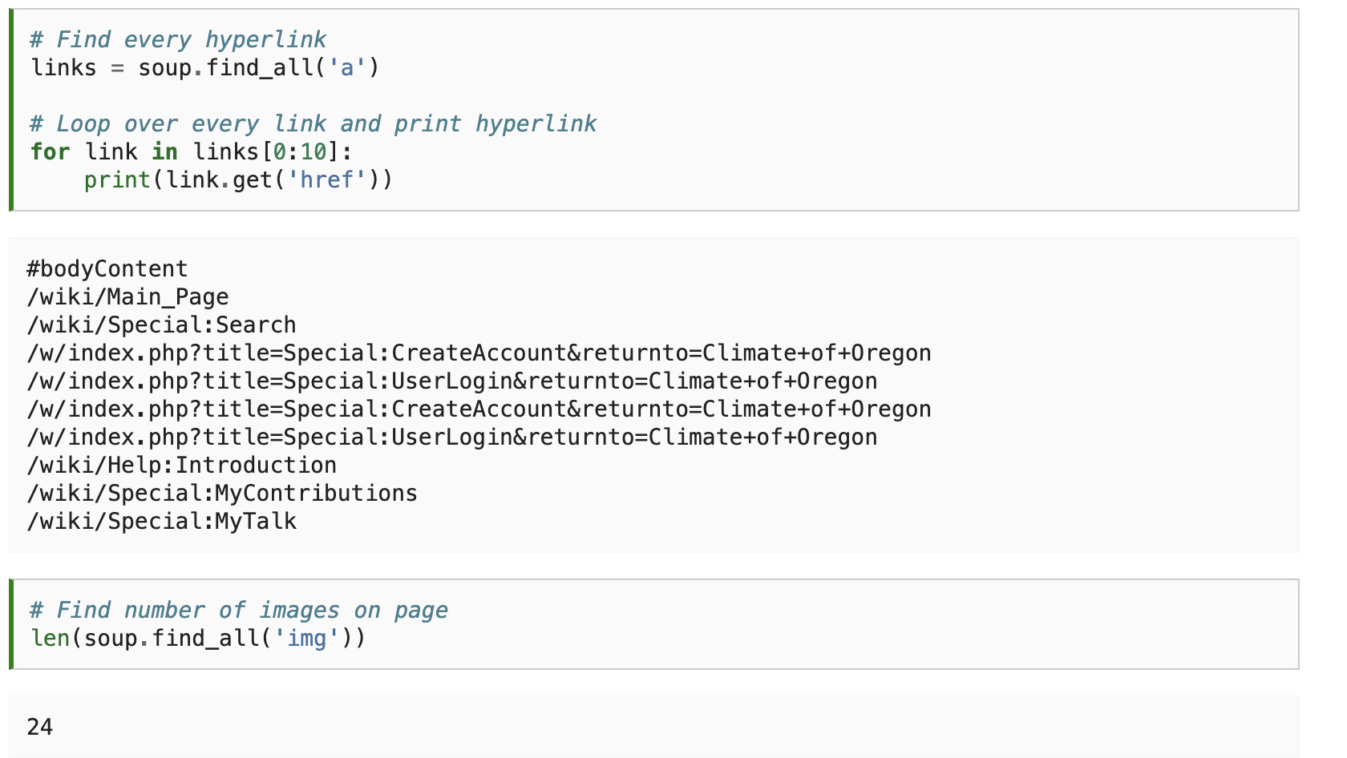

Slide 61
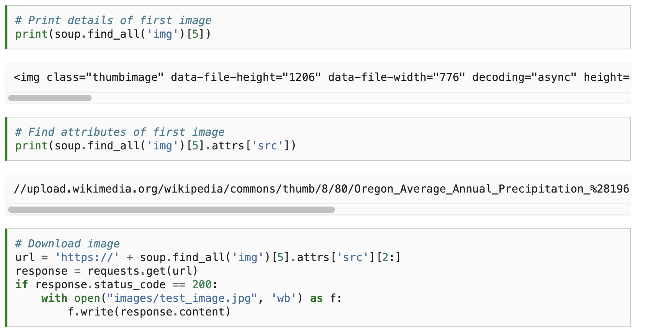

Slide 63
Notes:
Vigilantes showing that AirBnBs were not in compliance.

Slide 64
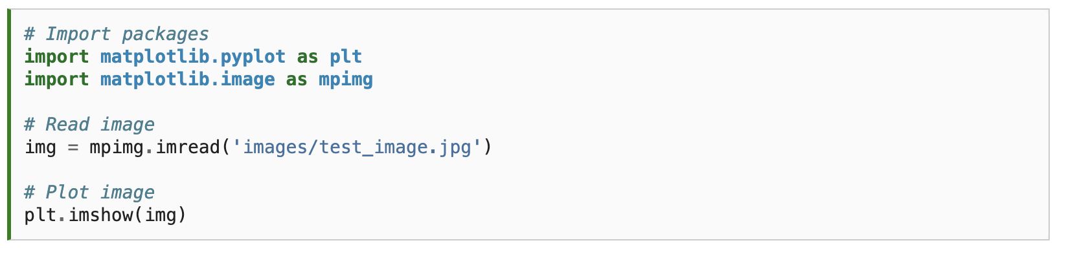


Slide 65


Slide 66


Slide 67


Slide 68

Notes:
Right-click → inspect

Slide 70


Slide 72


Slide 73



Slide 74


Slide 75


Slide 76


Slide 77


Slide 78
GEOG 4/590: Geospatial Data Science
Lecture 7: Data access
Code review – Assignment 5 (machine learning house prices)
Data access: APIs
census, USGS dataretrieval
Data access: Web scraping
Requests, bs4, selenium
Web scraping in my own research – golf course ownership
Email: jryan4@uoregon.edu
Office: 163A Condon Hall
Office hours: Mondays 14:00-16:00
Notes:
Being able to programmatically download web pages will extend your programs to the internet. The requests module makes downloading straightforward, and with some basic knowledge of HTML concepts and selectors, you can utilize the BeautifulSoup module to parse the pages you download. But to fully automate any web-based tasks, you need direct control of your web browser through the selenium module. The selenium module will allow you to log in to websites and fill out forms automatically. Since a web browser is the most common way to send and receive information over the internet, this is a great ability to have in your programmer toolkit.

Slide 79
Lab this week: Project work
Email: jryan4@uoregon.edu
Office: 163A Condon Hall
Office hours: Mondays 14:00-16:00

